Slide 1
Unit IV

Slide 2
Syllabus
Microcontroller Interfaces and Peripherals: Interfaces, protocols and peripherals used in embedded device: Serial and parallel ports, Inter-IC Bus (I2C), Serial Peripheral Interface (SPI), Interfacing common devices to ports such as switches, LEDs, buzzer, LCD displays, Relays, Motors and programming in C/C++.

Slide 3
Embedded Systems

Slide 4
Embedded Systems
Embedded Systems
A precise definition of embedded systems is not easy.
Simply stated, all computing systems other than general purpose computer based systems are embedded systems.
Energy
Heat
Computing
Machine
Inputs
Outputs
An Abstract View of Embedded System[1]

Slide 5
Embedded System
It is a computing system rather than general purpose computer with a dedicated function.
It is embedded as a part of complete device that includes hardware and software.
Embedded systems are managed by single or multiple processing cores in the form of microcontrollers or digital signal processors (DSP), field-programmable gate arrays (FPGA), application-specific integrated circuits (ASICs)

Slide 6
Typical Embedded System
FPGA/
ASIC
Software
Memory
Sensors
ADC
CPU
DAC
Actuators
Human
Interface
Diagnostic
Systems
Auxiliary
Systems
Backup & Safety
External Environment

Slide 7
Embedded Systems
Application Areas
Embedded systems are integral part of day-to-day life.
From smart phone to medical equipment, from microwaves to antilock breaking systems.
From life critical applications to security, from luxury to heavy duty.
From handheld gadgets to huge control systems.

Slide 8
Embedded Systems
Inside most of the devices, from a music player, a mobile phone, to cars, trains, medical equipment, and so on…..
More than humans on the planet, already
  40 billion of such devices by 2020
99% of processors used in embedded systems
  4 billion embedded processors sold last year
€71 billion global market in 2018, growth of 14%
  Market size is about 100 times the desktop market

Slide 9
Embedded Systems
Characteristics
Application specific & single functioned; application is known apriori.
Efficiency is of paramount importance for embedded systems. They
are optimized for energy, code size, execution time, weight,
dimensions, and cost.
Embedded systems are typically designed to meet real time constraints.
Embedded systems often interact (sense, manipulate & communicate)
with external world through sensors and actuators and hence are
typically reactive systems.
DNS

Slide 10
Embedded Systems
Embedded Systems are…
Combination of both Hardware and Software
Hardware forms the body of an embedded system, embedded processor acts as the brain,
Embedded software forms its soul. It is the embedded software which primarily governs the functioning of embedded systems.
Necessitates learning of embedded programming......

Slide 11
Embedded Systems
Design Approaches
Combined Hardware/Software approach.
Custom software that runs on of-the-shelf embedded processor.
Co-processor approach. A special processor with general purpose processor such as DSP, Graphic Processor, Hardware accelerator, etc..

Slide 12
Embedded Systems
Design Cycle
Requirements
Task partitioning
Specifications
Hardware Design
Design
Software Design
and Integration
Integration
Test Strategy
Maintenance
A typical “Water-Fall” model describing project life cycle

Slide 13
Embedded Systems
Design Considerations
Generally, in a final product ASIC is preferred.
In order to design near optimal system, before selecting final chip, and associated peripherals, designer has to consider:
    Cost
    Performance
    Power/Energy
    Flexibility
    Maintainability
    Size
    Time-to market

Slide 14
Embedded Systems
Design Challenges
For optimal embedded systems designs, today, designers have to face great challenges towards:
Choice of processor...........Survey of optimal processor to fit for a product
Short product lifetime........Tight project development schedule
Increase in complexity........High throughput processors which leads power dissipation
Special purpose hardware/software tools.......Relying on multiple vendors
DNS

Slide 15
Embedded Systems
Design Trends
Life cycle of embedded product becoming increasingly smaller, replacing outdated products leads: lower time-to-market
Complexity of embedded systems are rapidly increasing.
Consumer demands are increasing for more functionality and usability.
There exists a complexity gap between the application requirements and the capabilities of current silicon technologies
DNS

Slide 16
Moore’s Law and Shannon’s Law
Algorithmic Complexity
(Shannon’s Law)
Throughput requirements are growing faster than Moore's law
Fundamental flaws in software processor solutions
Contemporary processor requirement
Distributed processing is the way to go
Processor Performance
(log scale)
Processor
Complexity
(Moore’s Law)
Time (Years)
Source: Jan Robaey, Berkeley Wireless Research Centre
?

Slide 17
Technology Overview
Progress is made over the years in two domains:
Computing Domain
Technology Domain
DNS

Slide 18
Technology Overview
Computing Domain
Microprocessors/ Microcontrollers
Digital Signal Processors
ARM Core Chips
Network Processors

Slide 19





Microcontrollers
Dominant Players in Microcontroller Space
and many many more…….

Slide 20
Microcontroller Architectural Considerations

Slide 21
Microcontroller —Architectural Considerations
Review of some Architectural Concepts:
Input/
Output
Memory
System
Interconnection
Processor
The Computing System – Top Level Structure

Slide 22
Processor
  Controls the operation of the computing system and performs its data processing functions.
Memory Sub-System
  Stores data and programs.
Input/output Sub-System
  Moves information between the computing system and its external environment.
System Interconnection
  Some mechanism that provides for communication among the processor, the memory and the I/O sub-systems.

Slide 23
Microcontroller —Architectural Needs
What are the expected applications?
  Sensing the environment (Input)
  Producing a response (Output)
  The response may be delayed (Timer/Counter)
  Prioritized response (Interrupts)
  Communicating with external world (Serial/Parallel Communication)
  Software to control the process (Non-volatile Memory)
  Temporary data (RAM)

Slide 24
Microcontroller —Criterions to choose
Peripherals Support
Programmability and Reprogrammability.
Memory
Physical Packaging
Architecture
Development tools support
Power Consumption
Cost

Slide 25
Microcontroller —Families
There are several major “families” of microcontrollers available
from different manufacturers.
  A family is defined as a group of products that share the same basic internal architectures and who are code-compatible.
  Manufacturers usually define an architecture and then make variants of that design producing a family of products.
  Code written for a member of the family should be compatible with all other members of the same family.

Slide 26
Popular Microcontroller —Families Comparison
 | Intel MCS-51 | Microchip PIC | Atmel AVR | ARM
Bus width | 8-bit | 8/16/32 bit | 8/32-bit | 32 bit
Communication Protocols | UART, USART, I2C, SPI | UART, USART, I2C, SPI, LIN, CAN, Ethernet | UART, USART, I2C, SPI, LIN, CAN, Ethernet | UART, USART, I2C, SPI, LIN, CAN, USB, ethernet, Bluetooth, IrDA
Speed | 12 clock/instruction cycle | 4 clock/instruction cycle | 1 clock/instruction cycle | 1 clock/instruction cycle
Memory | ROM, SRAM, Flash | SRAM, Flash | Flash, SRAM, EEPROM | Flash, SDRAM, EEPROM
Architecture | Von Neuman (CISC) | Harvard (RISC) | Modified (RISC) | Modified Harvard (RISC)
Power Consumption | Average | Low | Low | Very Low
Cost | Very Low | Average | Average | High
Manufactures | NXP. Atmel, Silicon Labs, etc. | Microchip | Ateml | Nvidia, TI, Samsung, ST, etc.
Application Areas | Low end products | Wireless, medium end and low end products | Not that popular, similar uc for Automotive use | High end, medium end, IoT, Touch screen,

Slide 27
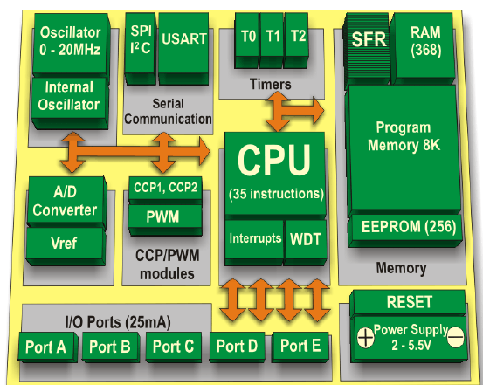
Microchip-PIC18F4550

Slide 28
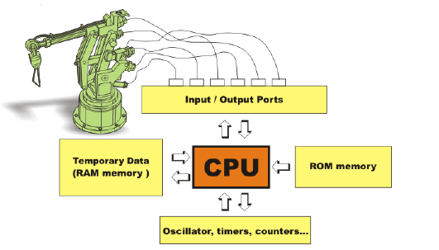
Use of I/O Ports

Slide 29
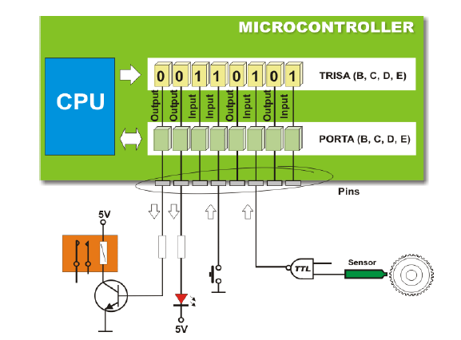
Use of I/O Ports

Slide 30
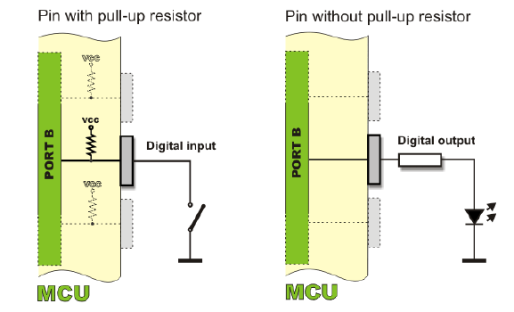
Use of I/O Ports

Slide 31
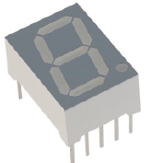
Seven Segment LED
Common Anode: When the ground potential is applied to any pin of LED, the
correspond LED glows.
Common Cathode: When the High signal is applied to any pin of LED, the
correspond LED glows.
a
Common Anode → ‘0’ == ON
Common Cathode → ‘1’ == ON
f
b
g
e
c
d
h
Notes:
In a Common Cathode LED, all the 8 legs ('a' through 'h') are of anode type and the common cathode will be connected to the GND of the supply. By energizing any of the legs with +5 Volts will lead to switch the correspondent segment ON. In the microprocessor binary system, 0 Volts will be considered as Binary 0, and 5 Volts will be considered as Binary1. Considering these two condition, we can make an arrangement as the microcontroller gives OUT the 0 s and 1 s through its ports, which is connected to the 8 legs of the LED. Of course, we can control the Port Output.

Slide 32
Look Up Table:
Hex Number | Seven Segment conversion |  |  |  |  |  |  |  | Seven Segment equivalent hex number
 | dot | g | f | e | d | c | b | a
0 | 1 | 1 | 0 | 0 | 0 | 0 | 0 | 0 | C0
1 | 1 | 1 | 1 | 1 | 1 | 0 | 0 | 1 | F9
2 | 1 | 0 | 1 | 0 | 0 | 1 | 0 | 0 | A4
3 | 1 | 0 | 1 | 1 | 0 | 0 | 0 | 0 | B0
4 | 1 | 0 | 0 | 1 | 1 | 0 | 0 | 1 | 99
5 | 1 | 0 | 0 | 1 | 0 | 0 | 1 | 0 | 92
6 | 1 | 0 | 0 | 0 | 0 | 0 | 1 | 0 | 82
7 | 1 | 1 | 1 | 1 | 1 | 0 | 0 | 0 | F8
8 | 1 | 0 | 0 | 0 | 0 | 0 | 0 | 0 | 80
9 | 1 | 0 | 0 | 1 | 1 | 0 | 0 | 0 | 98
Notes:
The lookup table contains the input pattern for the LED legs, to display the corresponding digits.
The table shows the seven segment requirement pattern to display the Hex number, with the Seven segment conversion.
For example, Let us consider to display the number 0, where we need to switch ON all the LEDs which are there at the boundary. i.e. for a Common anode LED, we should supply 0 volts to these LEDs. The 6 LEDs ('a' through 'f') should get binary 0, the dot and the (middle) hyphen segment should get 1 Volts or the binary one. Effectively the Seven segment pattern code will be (1100 0000) C0h. That is what we OUT through the port pins.
For a Common Cathode LED, the display pattern will be the complement of that of Common Anode pattern.

Slide 33
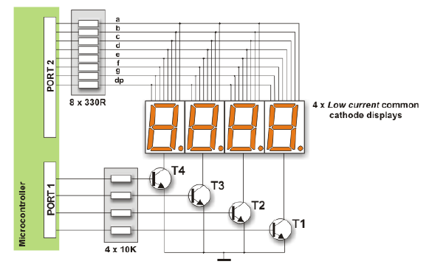
Multiplexing Way
Notes:
Figure 7.2 shows one of the possible interfacing connections of LCD controller with 8051.
P1.0 – P1.7 are connected to the LCD data pins D0-D7
P2.0 is connected to RS pin of LCD
P2.1 is connected to R/W pin of LCD
P2.2 is connected to E pin of LCD
The supply for LCD may be single power or Dual power
as shown in figure 7.3 VEE, contrast control in single power mode is connected to VCC through preset having value 10K to20K. In dual power mode it is connected to –5V and +5V through preset having value 10K to 20K.
VSS is connected to ground.

Slide 34
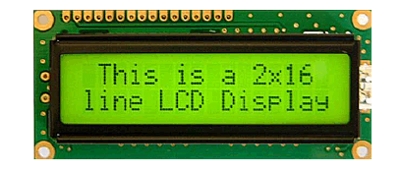
LCD Display

Slide 35
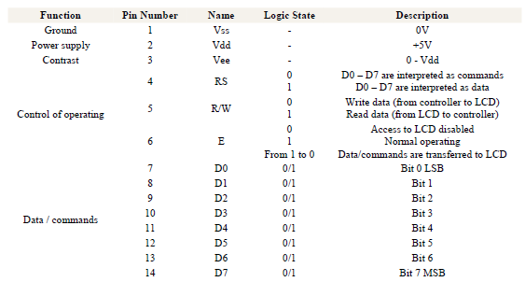
Pin-Connections

Slide 36
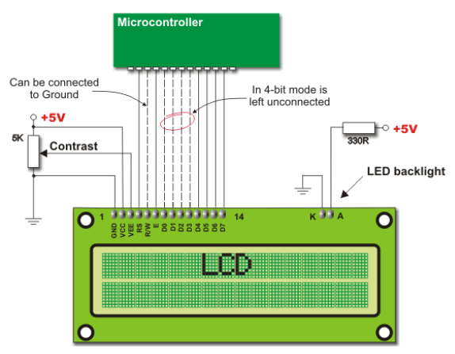
LCD-Connections

